Slide 1





Personal Finance Manager
Team :1] Tejas Karade (tejaskarade100@gmail.com) Guide: Vignesh Sir
2] Jayesh Lambdade (jaylambdade@gmail.com)
Disclaimer: The content is curated for educational purposes only.
Notes:
Slides: Prepare a short slide deck (10-12 slides) summarizing the project objectives, methodology, and key results.

Slide 2
OUTLINE
Abstract of the Project
Problem Statement
Proposed Solution
System Architecture
Live Demo of the Project
Embedded Video of Project
Conclusion
Future Scope

Slide 3
Abstract:
Title: Personal Finance Manager
Overview: A Python-based GUI application to manage personal finances effectively
Key Features:
Track income and expenses
Categorize transactions
Set and monitor budget goals
Visualize financial health through charts
Purpose: Empower users to maintain control over their finances with an intuitive interface
Technologies: Python, Tkinter, Matplotlib, JSON for data storage

Slide 4
Problem Statement
Financial Management Challenges:
Difficulty tracking daily income and expenses manually
Lack of visibility into spending patterns
Inability to set and adhere to budget limits
No easy way to visualize financial data
User Pain Points:
Time-consuming to maintain spreadsheets
Limited accessibility to financial insights
Risk of overspending without real-time monitoring
Need: A user-friendly, automated tool to simplify personal finance management

Slide 5
Proposed Solution
Solution: Personal Finance Manager with GUI
Core Functionalities:
Add income and expense transactions with categories and descriptions
View transaction history in a tabular format
Set budget goals for spending categories
Monitor current balance
Generate visual reports (pie chart for spending, bar chart for budget progress)
Benefits:
Real-time financial tracking
Persistent data storage in JSON
Interactive and visually appealing interface
Easy-to-understand financial insights

Slide 6
System Architecture
Components:
Frontend: Tkinter-based GUI with tabs (Transactions, Budget, Reports)
Backend: Python classes (Transaction, FinanceManagerGUI)
Data Storage: JSON file (finance_data.json) for persistence
Visualization: Matplotlib for charts (pie and bar)
Workflow:
User inputs transactions or budgets via GUI
Data processed and stored in JSON
Transactions displayed in Treeview
Reports generated and visualized on demand
Libraries Used:
tkinter, ttk for UI
matplotlib for charts
json for file handling
Structure:
Object-oriented design with separate concerns (UI, data, logic)

Slide 7
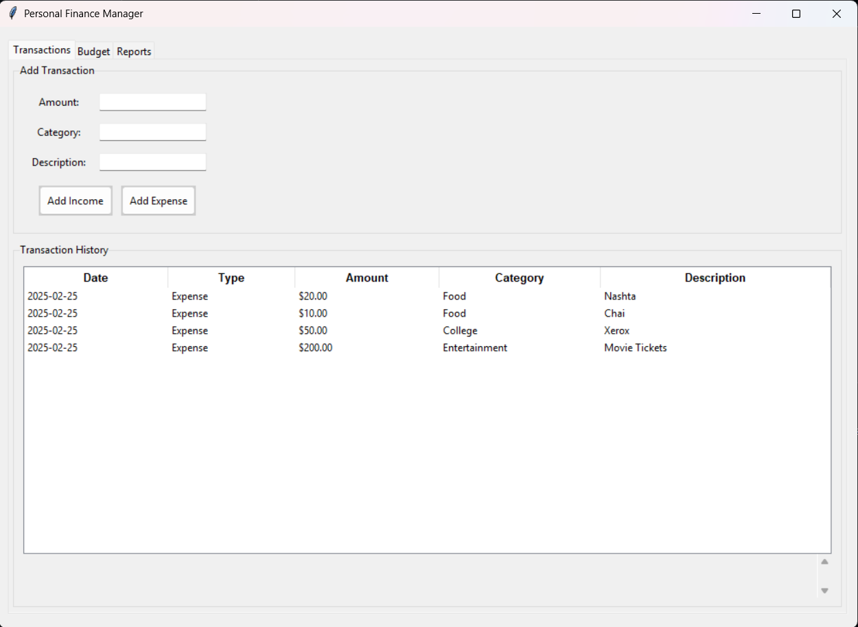
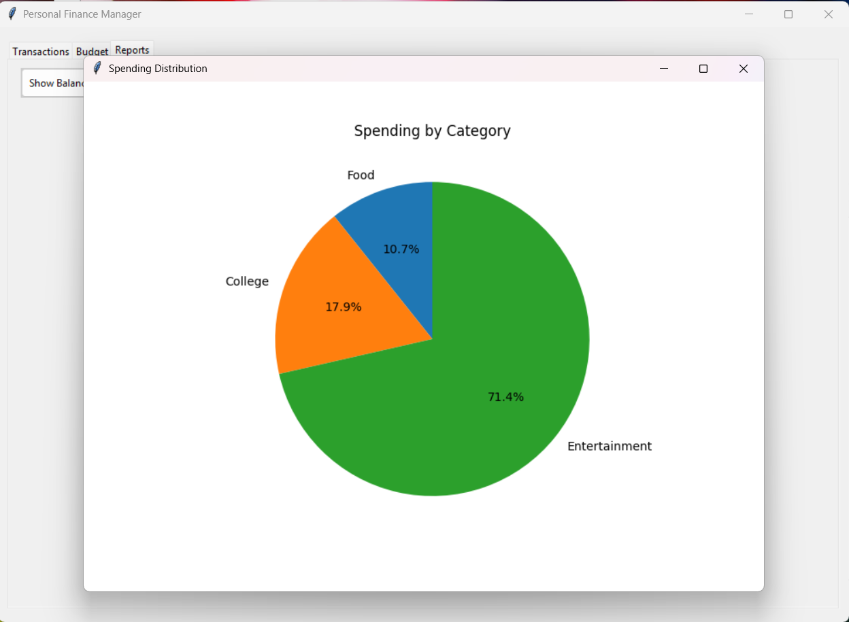
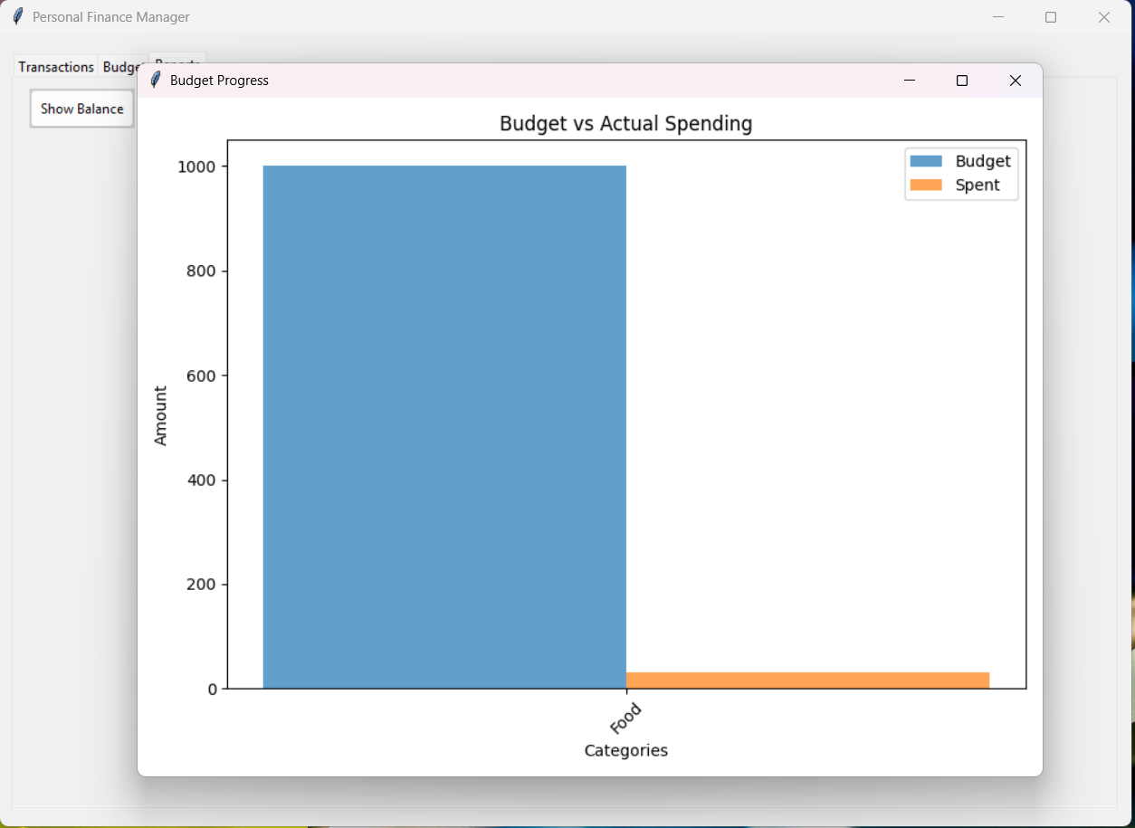
Live Demo of Project
GitHub Link:

Slide 8
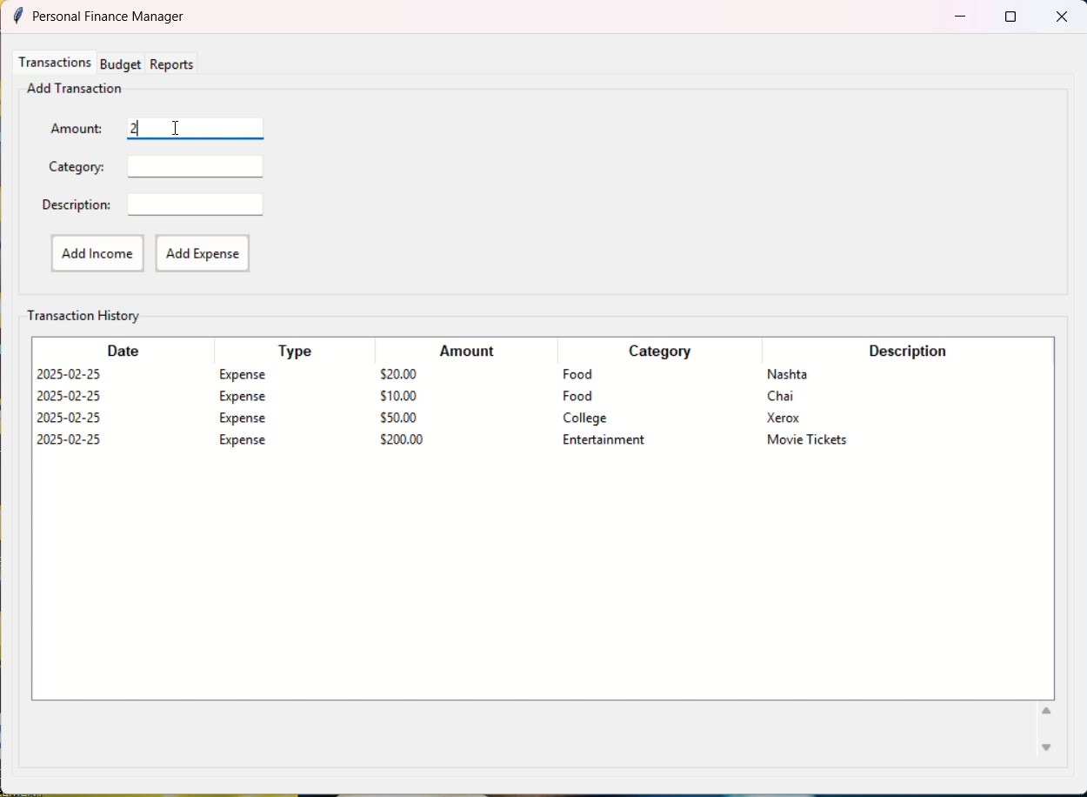
Video of Project Demo

Slide 9
Conclusion
Achievements:
Successfully implemented a functional finance manager
User-friendly GUI with transaction viewing and budget tracking
Reliable data persistence and error handling
Effective visualizations for financial analysis
Impact:
Simplifies personal finance management
Provides actionable insights into spending habits
Encourages better budgeting practices
Outcome: A practical tool for everyday financial control

Slide 10
Future Scope
Enhancements:
Add date range filtering for transactions and reports
Implement user authentication for multiple profiles
Export data to CSV/PDF for external use
Integrate reminders for budget limits or recurring transactions
Advanced Features:
Mobile app version using Kivy or similar frameworks
Cloud sync for access across devices
Predictive analytics for spending trends
Currency conversion for international use
Scalability:
Expand to small business finance management
Add investment tracking capabilities

Slide 11
Thank you!
Notes:
thank you very much for joining this PPT, keep learning.
11

